Slide 1
Visage Vantage: Harnessing the power of facial image recognition
Simranjeet kaur Devgun (0176CD201060)
Vanshika Saxena (0176CD201066)

Slide 2
Introduction
In the era of digital communication, where a picture is worth a thousand words, VisageVantage emerges as a revolutionary tool that goes beyond traditional facial image recognition. This cutting-edge technology seamlessly combines the power of advanced facial recognition algorithms with the expressive language of emojis, offering a unique and dynamic way to convey emotions through visual communication.

Slide 3
Problem statement
Human facial expressions can be easily classified into 7 basic emotions: happy, sad, surprise, fear, anger, disgust, and neutral. Our facial emotions are expressed through activation of specific sets of facial muscles. These sometimes subtle, yet complex, signals in an expression often contain an abundant amount of information about our state of mind. Through facial emotion recognition, we are able to measure the effects that content and services have on the audience/users through an easy and low-cost procedure.

Slide 4
Start
Iterative Refinement: - Refines the system based on user feedback to enhance accuracy, user satisfaction, and overall performance.
End
User Feedback: - Gathers user feedback through surveys, reviews, and analytics.
Facial Image Recognition: a. System captures facial features and expressions. b. Utilizes deep learning algorithms for facial expression analysis.
Emotion Classification: - Classifies facial expressions into predefined emotion categories (e.g., happy, sad, surprised).
Emoji Mapping: - Maps classified emotions to a diverse set of expressive emojis.
Real-Time Update: - If in real-time mode, dynamically updates emojis based on evolving facial expressions during user interaction.
Privacy and Security: - Ensures the ethical use of facial recognition data and implements strong privacy measures.
User Interaction: - User uploads a photo or engages in real-time facial expression analysis through a camera.

Slide 5
ABOUT ViageVantage
VisageVantage takes the concept of facial image recognition to new heights by not only identifying faces but also interpreting the emotions they convey. This innovative platform employs state-of-the-art artificial intelligence to analyse facial features, expressions, and gestures, translating them into a rich spectrum of emojis that accurately reflect the nuances of human emotion.

Slide 6

01
02
03
04
Some of applications involving facial emotion
Gaming and Virtual Reality
Social Media Engagement:
Market Research and Advertising
Education

Slide 7
How it works
The process is simple yet sophisticated: users upload their photos to the VisageVantage platform, and within moments, the advanced facial recognition algorithms get to work. The system analyses the subtlest details of facial expressions, capturing joy, surprise, sadness, and everything in between. The result? A personalized set of emojis that encapsulate the emotional essence of the image.

Slide 8
MINIMUM SYSTEM REQUIREMENTS
HARDWARE REQUIREMENTS
Processor: Intel CORE i5 processor with minimum 2.9 GHz speed.
RAM: Minimum 4 GB.
Hard Disk: Minimum 500 GB
High quality Camera or Webcam
SOFTWARE REQUIREMENTS
Compatible with Windows Operating System 10 or above
Programming Language: Python 3.7 or above
IDE (Integrated Development Environment): PyCharm or any preferred IDE.
Web Technologies: HTML, CSS and JavaScript
Web Framework: Flask

Slide 9
Library and Packages:
OpenCV:OpenCV is a powerful open-source computer vision and machine learning library that provides tools for image and video processing, including capabilities for object detection, facial recognition, and image manipulation.
NumPy:NumPy is a fundamental library for scientific computing in Python, enabling efficient handling of large, multi-dimensional arrays and matrices. It provides essential mathematical functions and supports operations for numerical computations.
SciPy:SciPy is built on top of NumPy and extends its capabilities by providing additional functionality for scientific computing. It includes modules for optimization, integration, interpolation, signal and image processing, linear algebra, and more
Keras:Keras is a high-level neural networks API that runs on top of TensorFlow (or other backends). It provides a user-friendly interface for building and experimenting with deep learning models, making it easier to design and train neural networks for various tasks.
Top of Form
TensorFlow:TensorFlow is an open-source machine learning framework developed by Google. It facilitates the creation and deployment of machine learning models, particularly deep learning models, through a flexible and comprehensive platform.
Matplotlib:Matplotlib is a versatile plotting library for creating static, animated, and interactive visualizations in Python. It allows users to generate a wide range of high-quality plots and charts for data exploration and presentation.

Slide 10
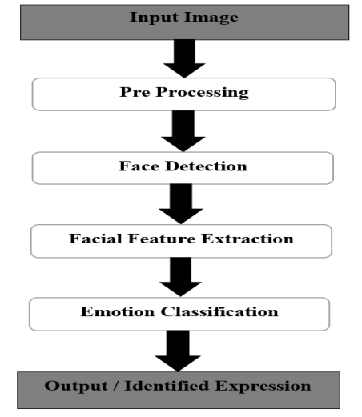

Slide 11
Process
Input images
Pre- processing
Face detection
STEP 1
STEP 2
STEP 3
STEP 4
STEP 5
Facial feature extraction
Emotion classification
Then output or identified emotion

Slide 12
Methedology

Slide 13
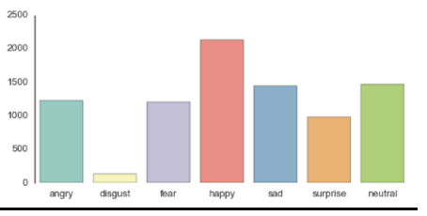
The Database: The dataset we used for training the model is from a Kaggle Facial Expression Recognition Challenge a few years back (FER2013). It comprises a total of 35887 pre-cropped, 48-by-48-pixel grayscale images of faces each labeled with one of the 7 emotion classes: anger, disgust, fear, happiness, sadness, surprise, and neutral.

Slide 14
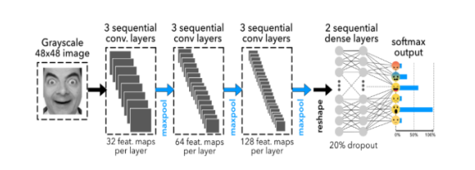
The Model:Deep learning is a popular technique used in computer vision. We chose Convolutional Neural Network (CNN) layers as building blocks to create our model architecture. CNNs are known to imitate how the human brain works when analyzing visuals. We have used a picture of Mr. Bean as an example to explain how images are fed into the model, because who doesn’t love Mr. Bean?
A typical architecture of a convolutional neural network contains an input layer, some convolutional layers, some dense layers (aka. fully-connected layers), and an output layer. These are linearly stacked layers ordered in sequence.
In Keras, the model is created as Sequential () and more layers are added to build architecture.

Slide 15
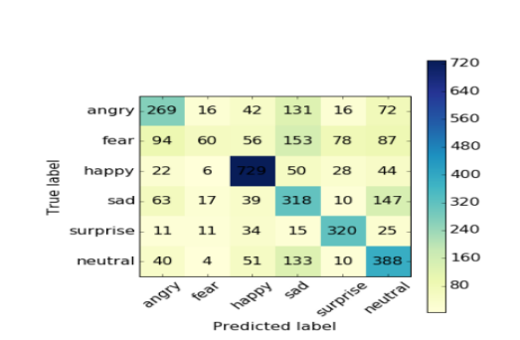
Model Validation:Performance As it turns out, the final CNN had a validation accuracy of 65%. This actually makes a lot of sense. Because our expressions usually consist a combination of emotions, and only using one label to represent an expression can be hard. In this case, when the model predicts incorrectly, the correct label is often the second most likely emotion as seen in figure below

Slide 16
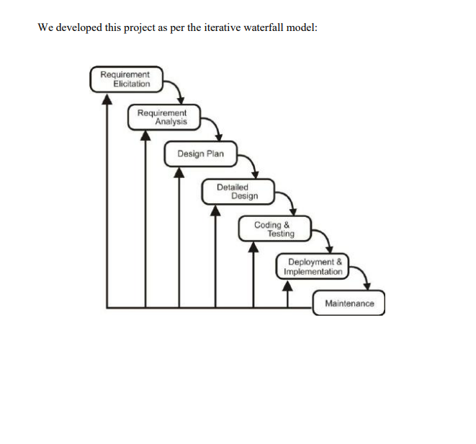

Slide 17
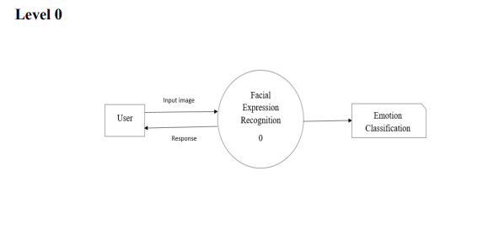
DATA FLOW DIAGRAM

Slide 18
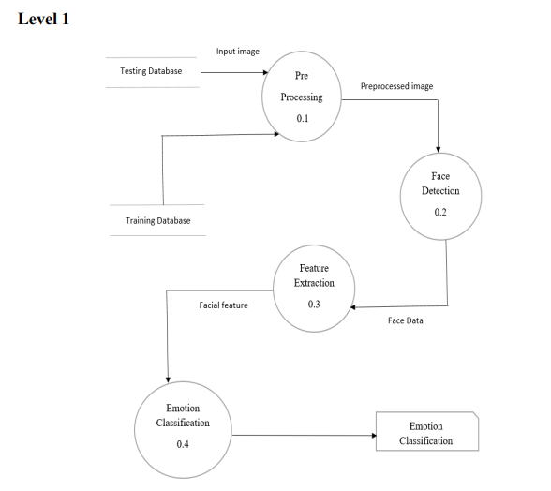

Slide 19
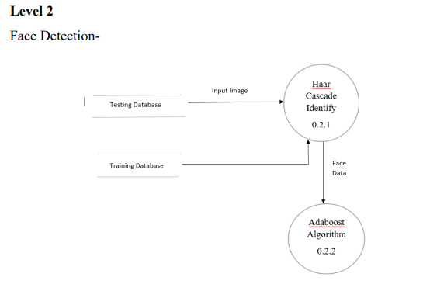
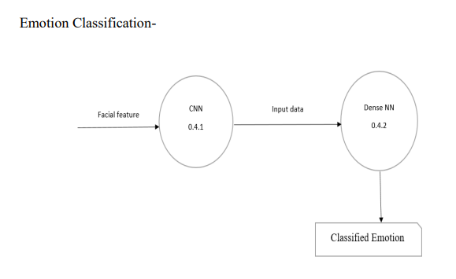

Slide 20
Working Screen-shot

Slide 21


Slide 22


Slide 23


Slide 24

Home page

Slide 25


Slide 26
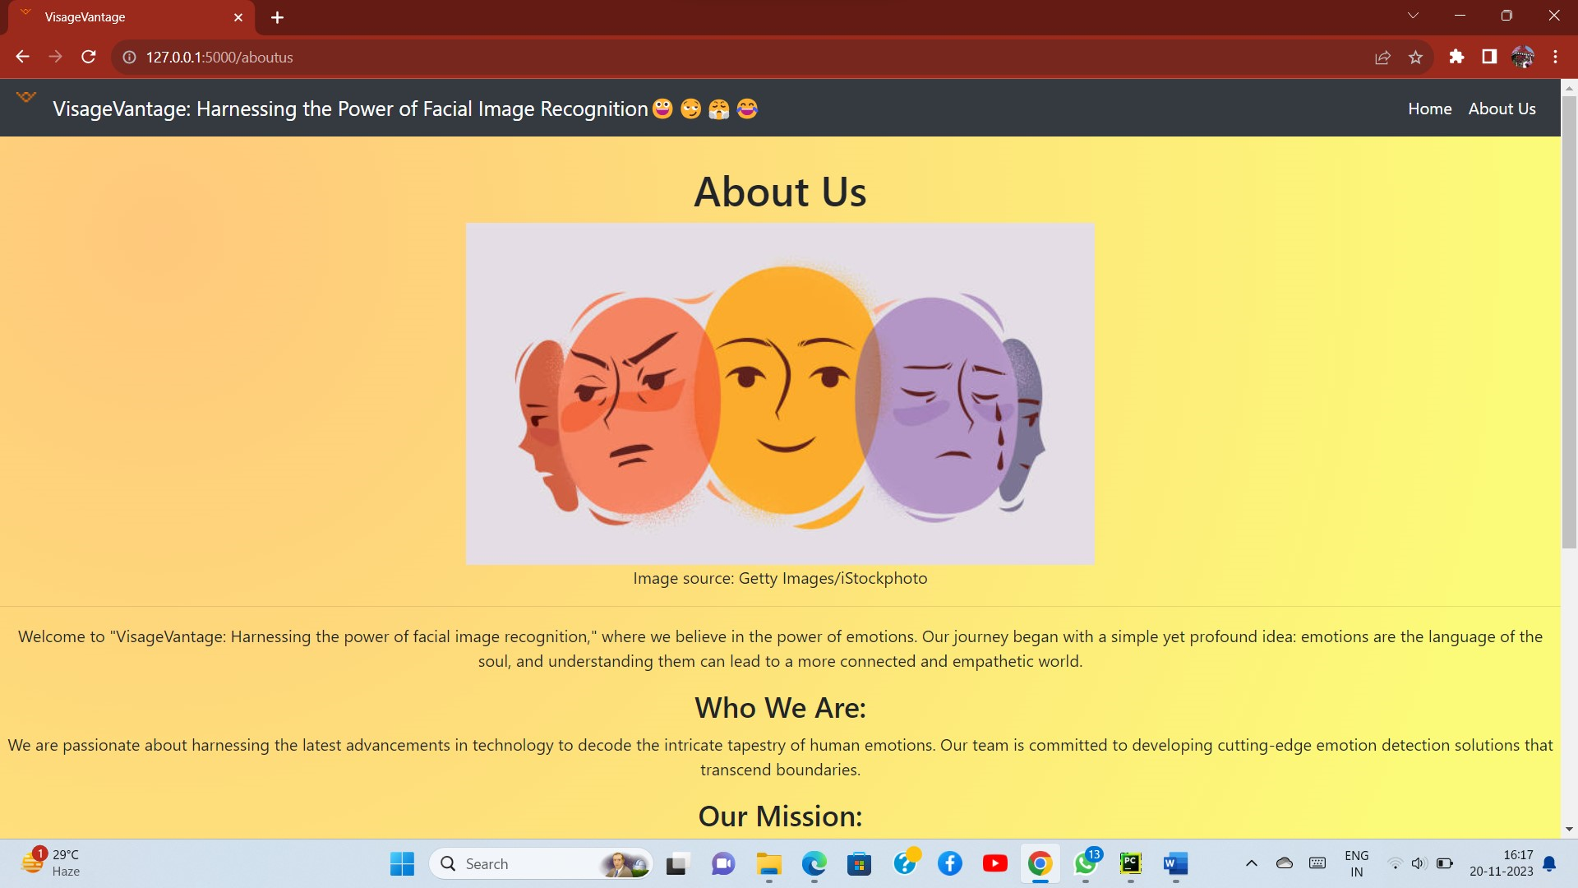


Slide 27



Slide 28
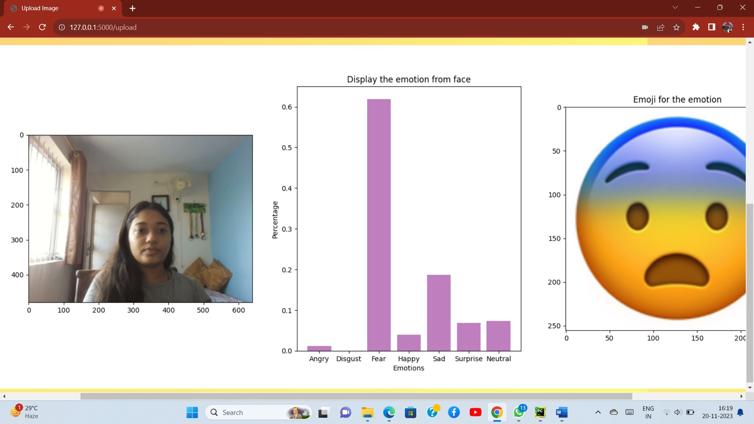

Slide 29
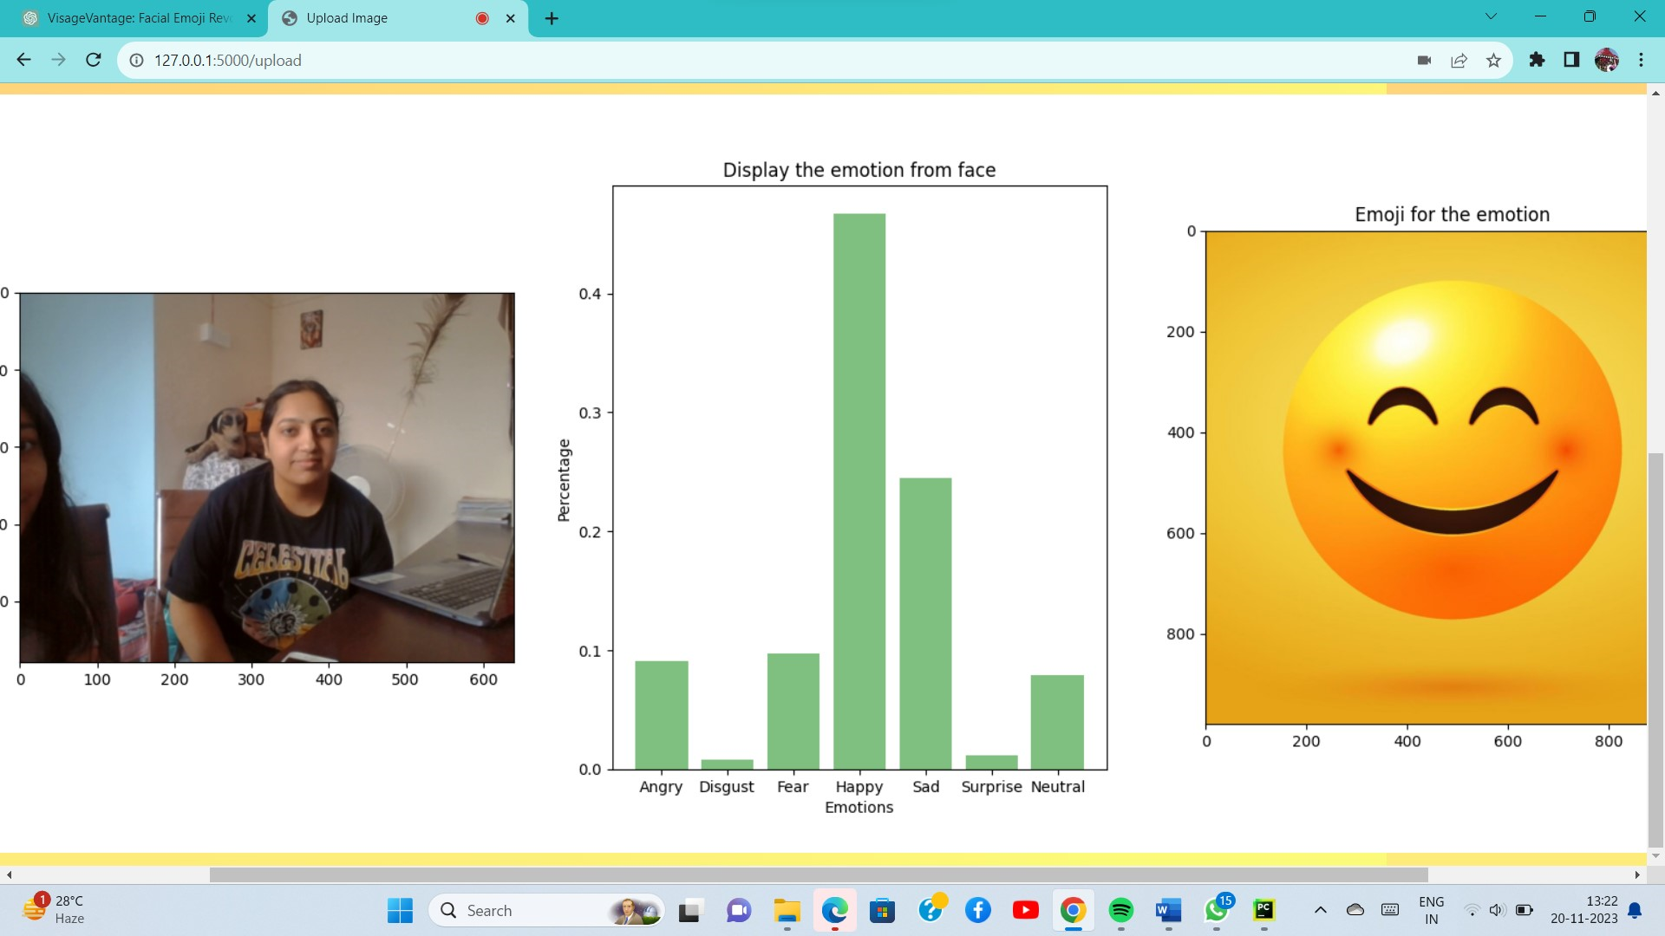
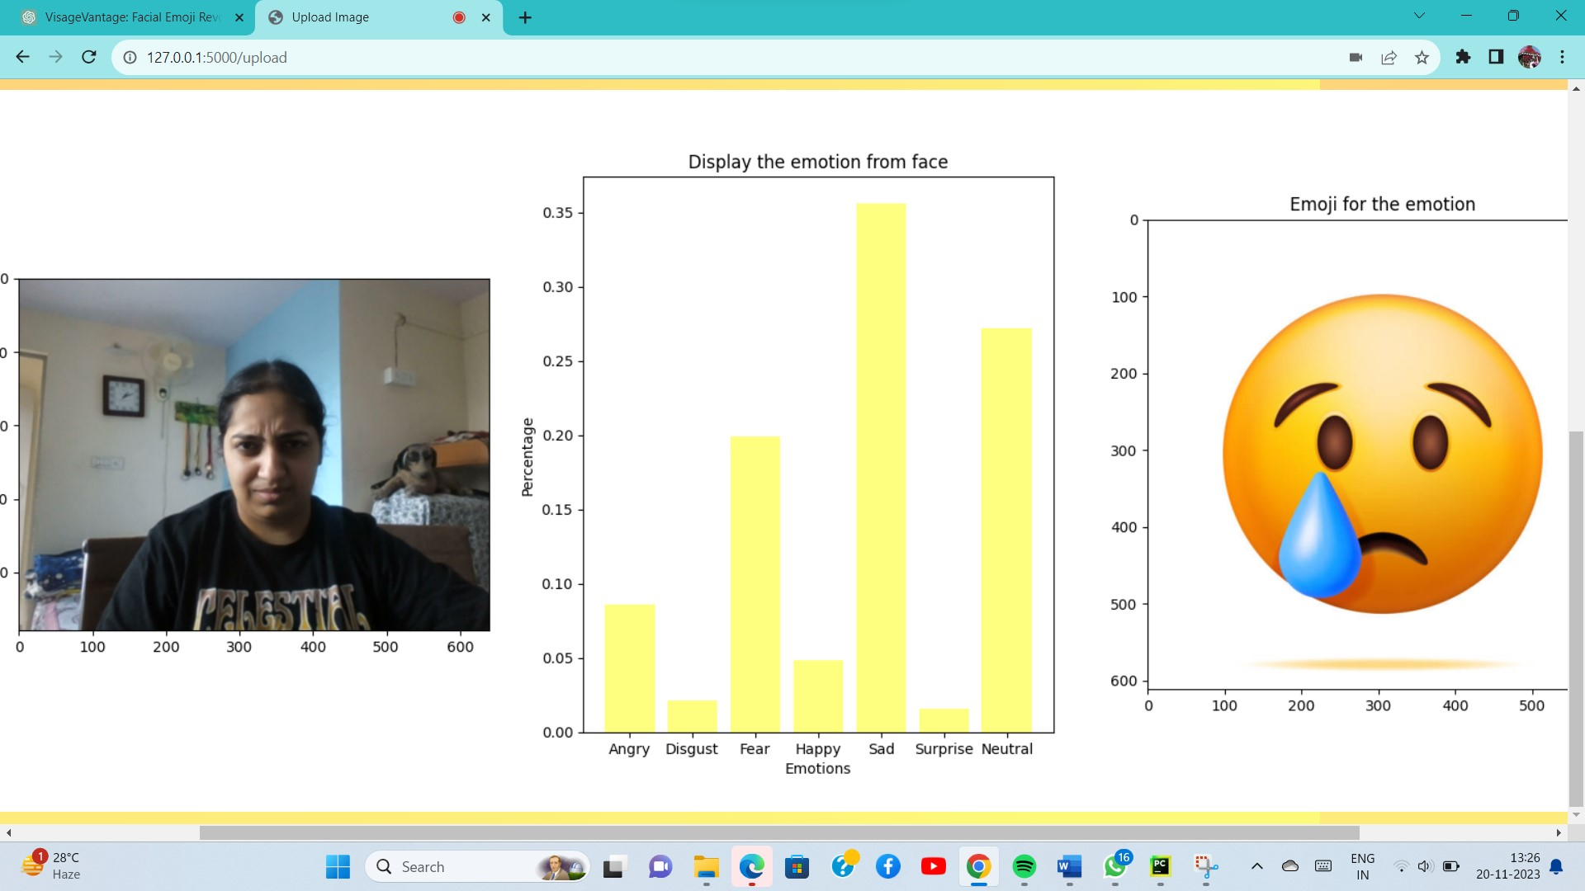
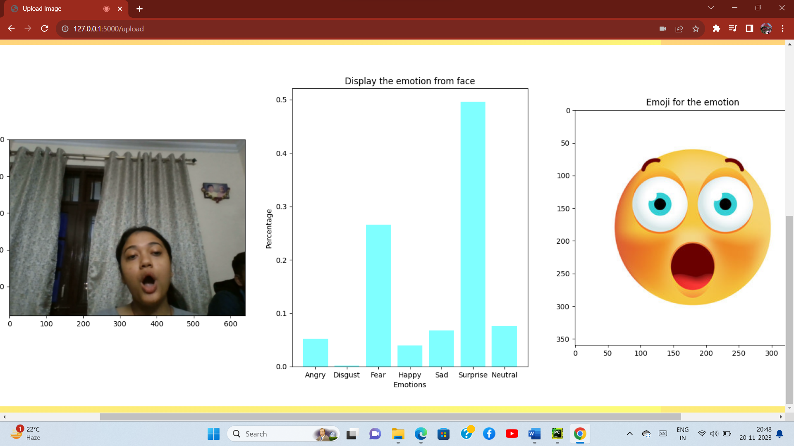
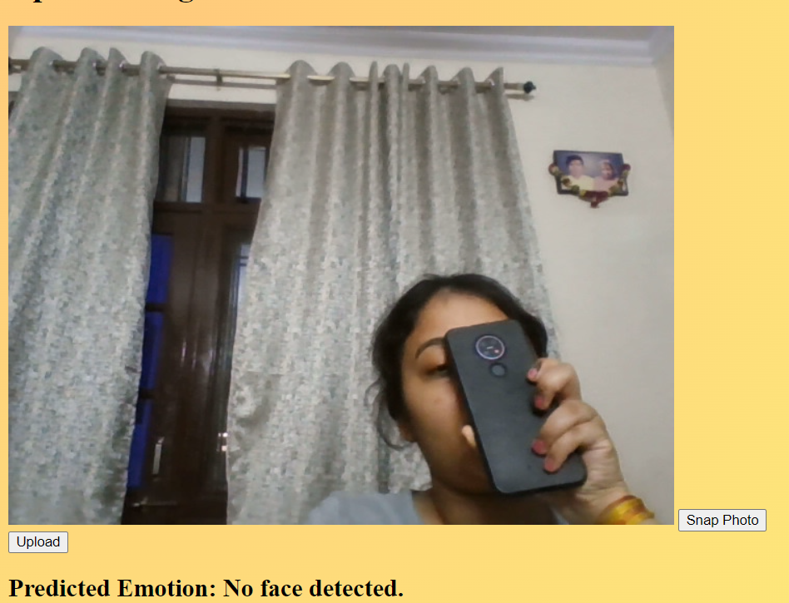
Some more examples

Slide 30

The facial expression recognition system presented in this research work contributes a resilient face recognition model based on the mapping of behavioral characteristics with the physiological biometric characteristics. The physiological characteristics of the human face with relevance to various expressions such as happiness, sadness, fear, anger, surprise and disgust are associated with geometrical structures which restored as base matching template for the recognition system.
conclusion

